Slide 1
UE 60: de la piața unică la integrarea diferențiată
Grafice

Slide 2
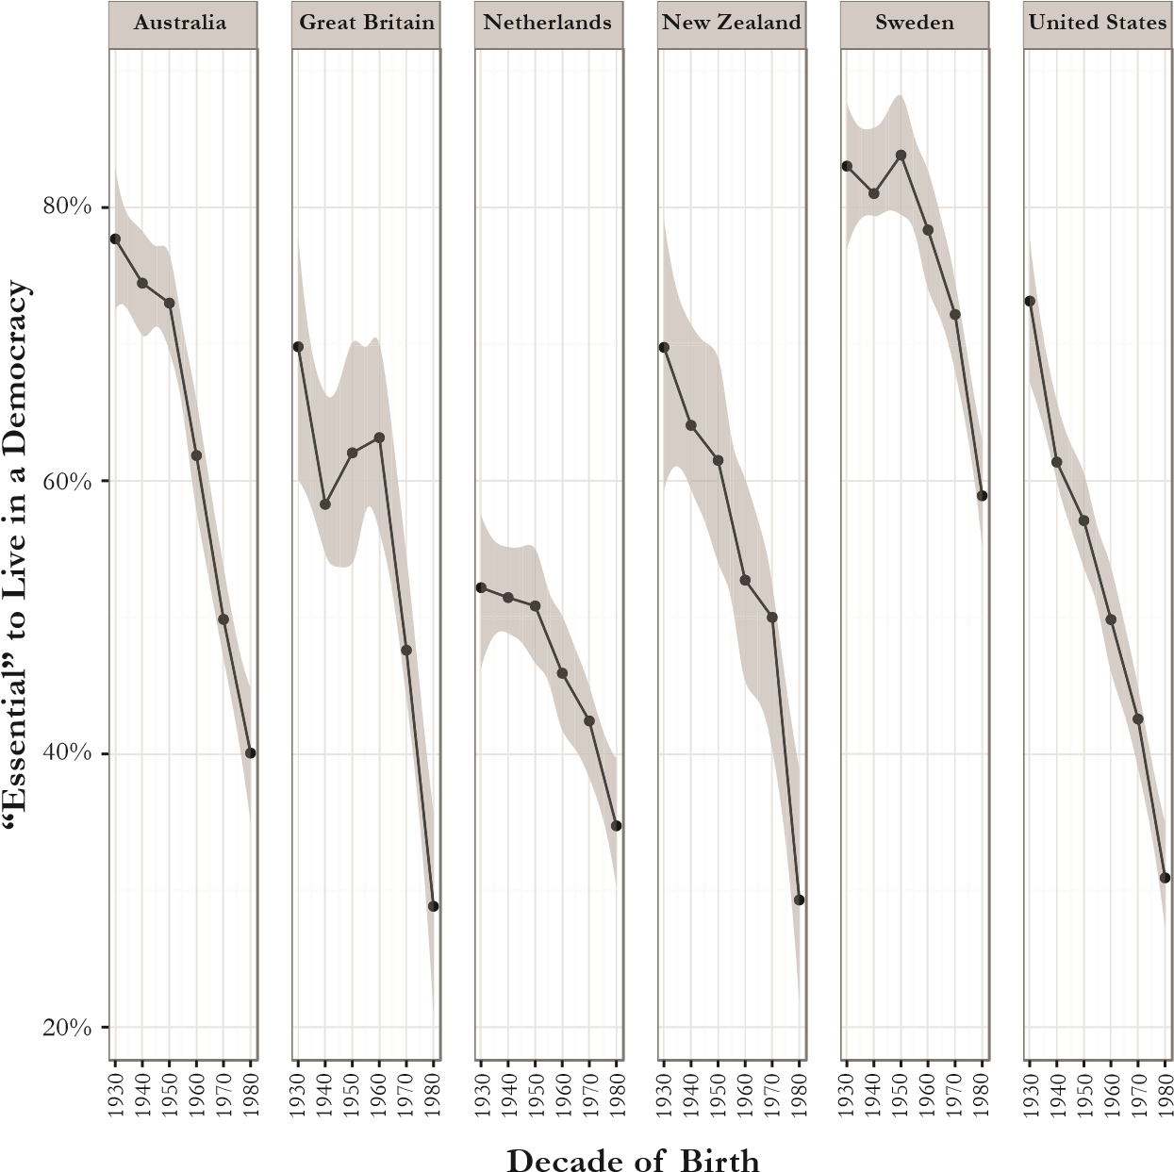
Across the Globe the Young are less invested in Democracy Source: European and World Values Surveys, combined data from Waves 5 and 6 (2005–7 and 2010–14). Percentage of respondents rating it “essential” (a rating of 10 on a 10-point scale) to “live in a country that is governed democratically.” Note: Confidence intervals appear in gray. Journal of Democracy, January 2017

Slide 3
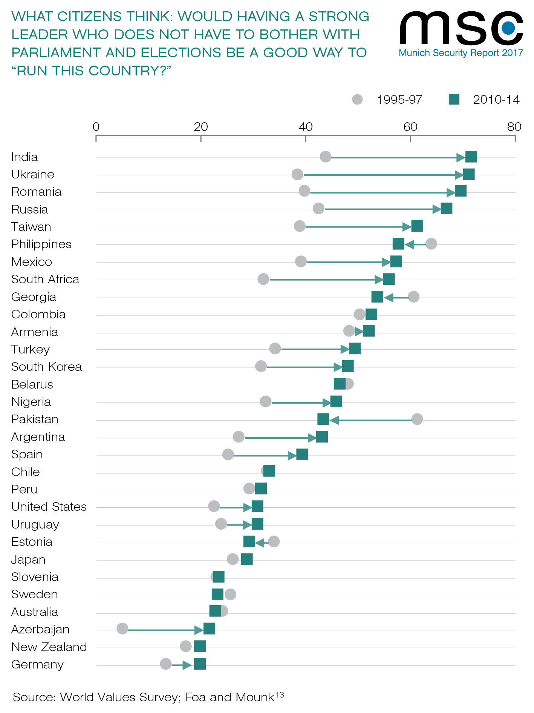

Slide 5
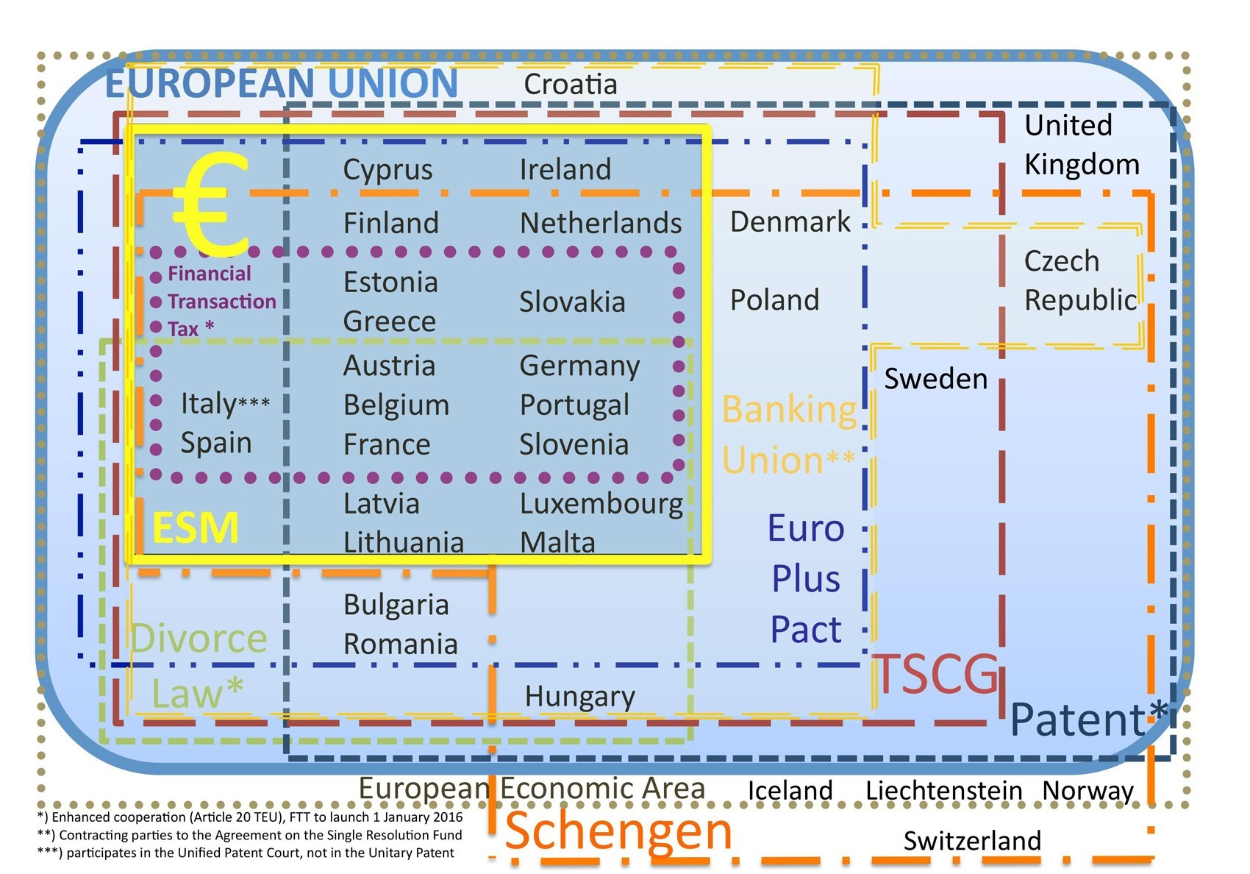
Differentiated EU Integration

